Slide 1

Streamlining and Optimizing Asset Management System for IniTech Solutions
Name: Rishabh Singh
Assignment Name: Milestone 4

Slide 2
CONTENT
Problem Statement
Technology Solution
Project Benefits
Business Function 1
Process Map
Function 2
Process Map
Business Function 3
Process Map
Business Function 4
Process Map
Infrastructure Architecture - Network Topology
Infrastructure Architecture - Entity Relationship Diagram
Technology Tools
References

Slide 3
Problem Statement
Some loopholes like data inconsistency, lack of reporting features, poor data management, duplicate data, and inability to track the asset stage were identified in the previous audit cycle along with streamlining the deploy, service and retirement processes for Asset Management System for IniTech Solutions.

Slide 4
Technology Solution
A centralized web-based application connected to a database maintaining the asset data along with its proper serialized and uniquely identifiable tags and state supporting report generation feature.
Serialized assets, Stockroom Management, Asset Entry that includes Request Process and System Security are the four major functions that can be completed by the user.

Slide 5
Project Benefits
1. Asset Manager – Economical and Technological factors -
In effectively managing all the assets of the company and make better investment decisions on when to order new laptops and other devices.
In distributing already available assets to the employees and keep track of them.

Slide 6
Project Benefits
2. Director IT Services Management – Technological factor
- Increases automation, reducing manual labor for tasks such as data entry, collection of data and merging of data. Helps in reducing data validation errors and man-made errors.
3. Facilities Management Director – Economical and Technological factors
- Management of devices will be easier and more user-friendly.

Slide 7
1. Serialized Assets
Serialized Asset tracking is a collection of assets which are associated with the appropriate model or device which includes a serial numbers, asset tag, state of the asset, location, condition, model, and assigned to.
Serialized Asset inventory will track the on-hand quantity for a Stock Item and a serial number for a specific unit.
The serialized units will be placed into service, removed, repaired, returned to stock and re-issued for service.Serial Numbers, also serve as the Asset Tag ID
A Stock Item will be selected from a Stock Item record.The items in the stock will be assigned by the Asset Manager if it is in use.

Slide 8
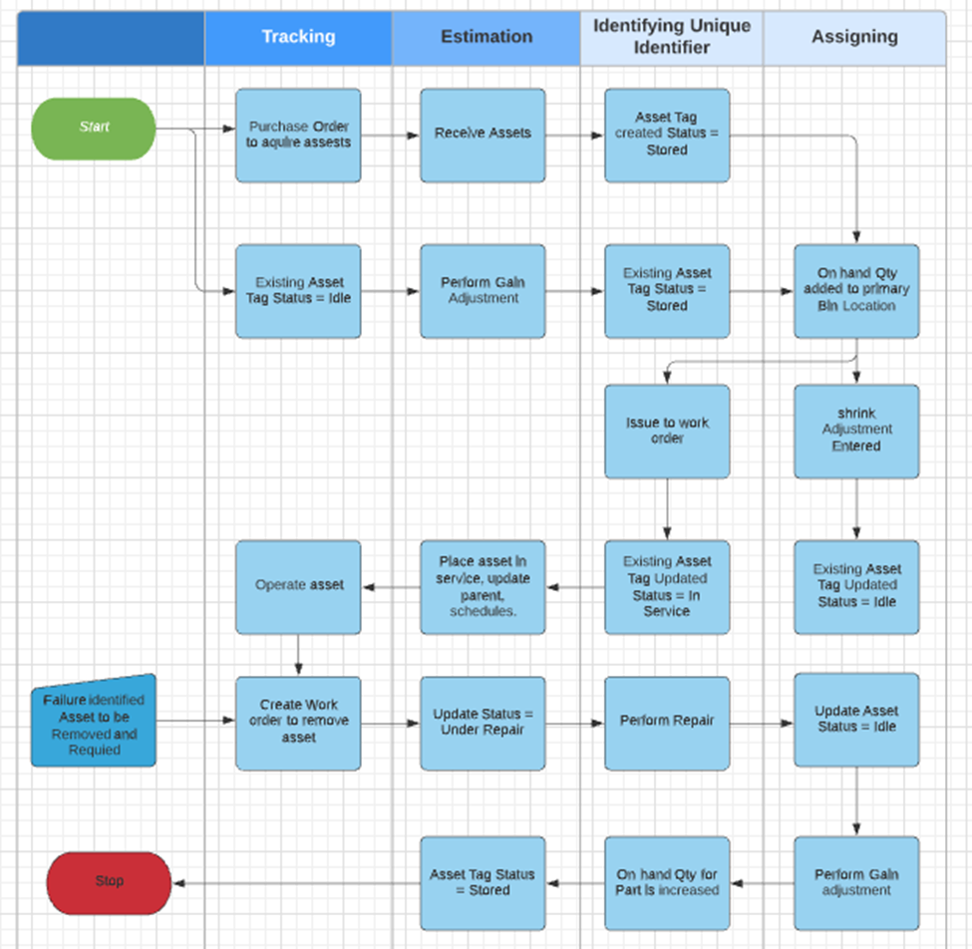
Process Map for Serialized Assets

Slide 9
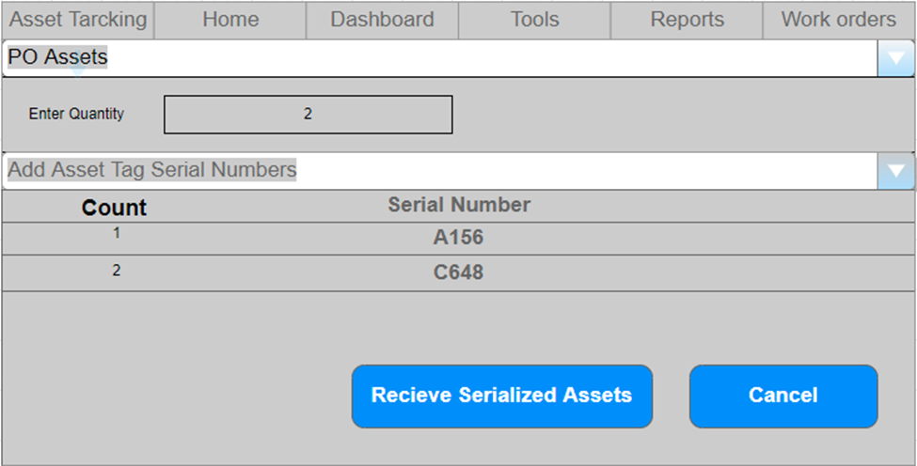
Serialized Assets Tracking

Slide 10
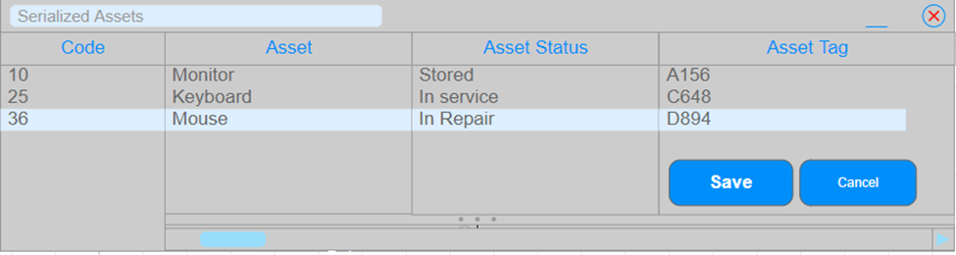
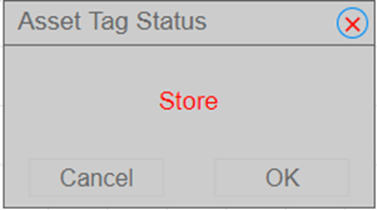
Asset Status

Slide 11
2. Stockroom Management
Stockrooms are separate standalone entities, places, or locations, consisting of a building identifier or a room that are needed to assign IT assets when they are in-stock.
The Owners of a Stockroom include the Asset Manager, who is responsible for the devices that are in the stock room and the Facilities Management Director who is responsible for the room itself and all the surrounding infrastructure.
Stockroom management assists businesses in knowing exactly where their products or assets are, keeping an accurate count on all items, and making room for new orders.
Purpose:

Slide 12
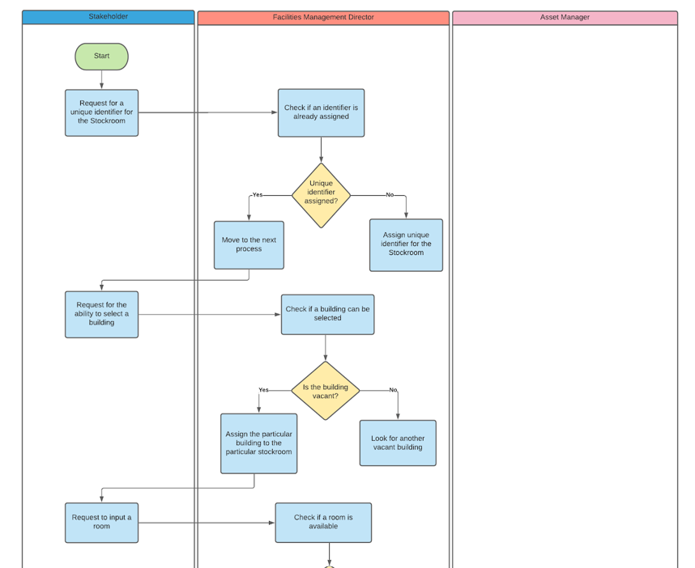
Process Map for Stockroom Management

Slide 13
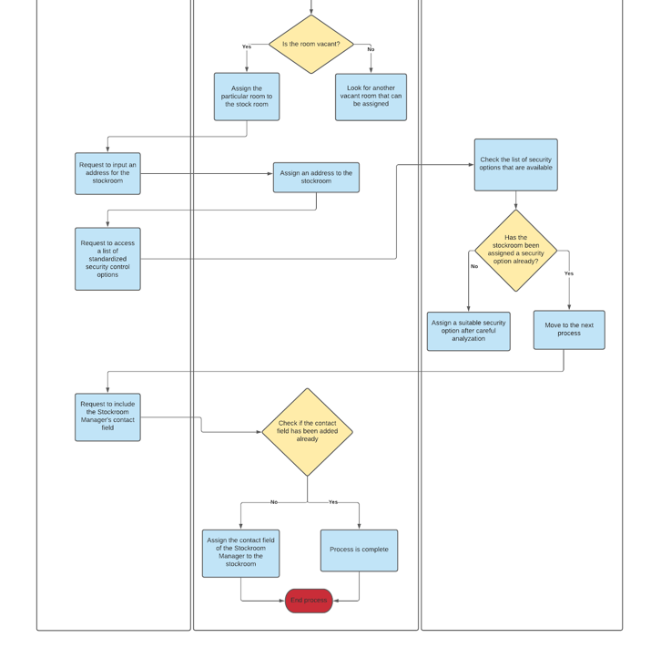


Slide 14
3. IT Asset Management
Two main processes: Asset Entry and Asset Request
Asset Entry:
To create new entries for the new assets
Provide facility for tagging and generating unique IDs for each asset
Also includes provision for creating new stockrooms.
Request Process:
Facilitates the users to submit an order for an In-stock(available) item from the stockroom.

Slide 15
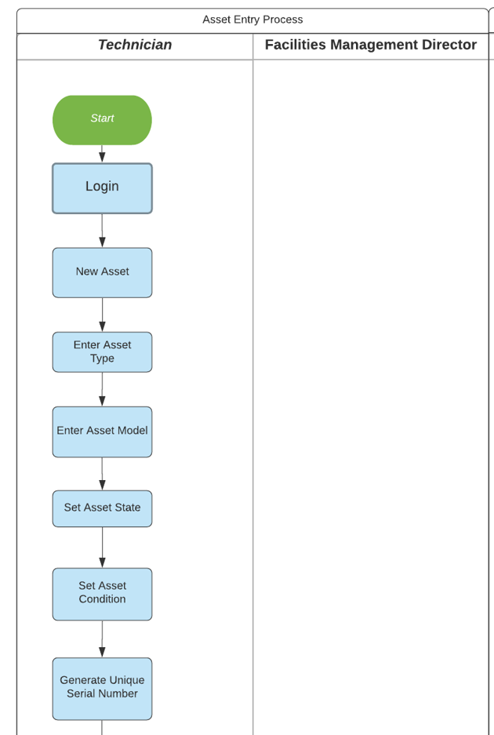
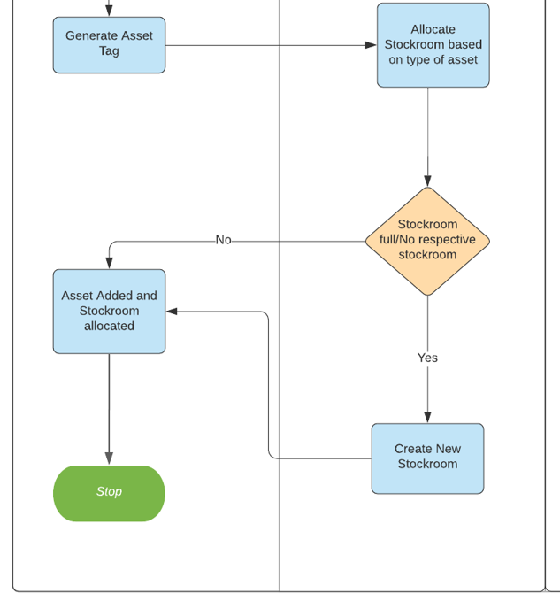
Asset Entry Process

Slide 16
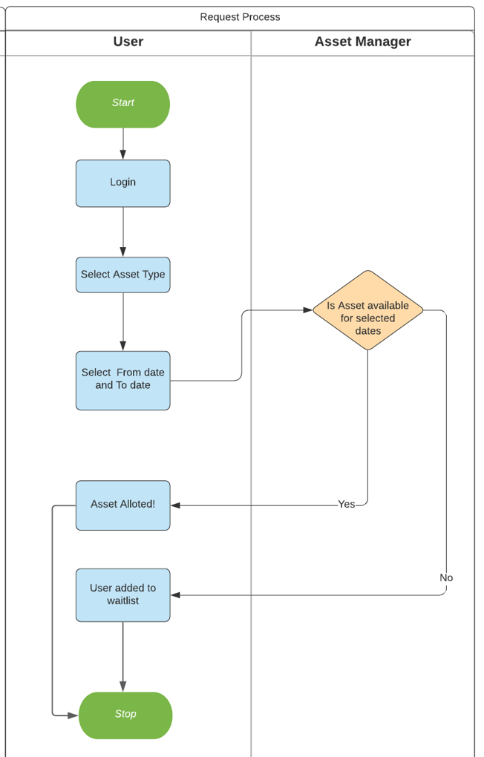
Asset Request Process

Slide 17
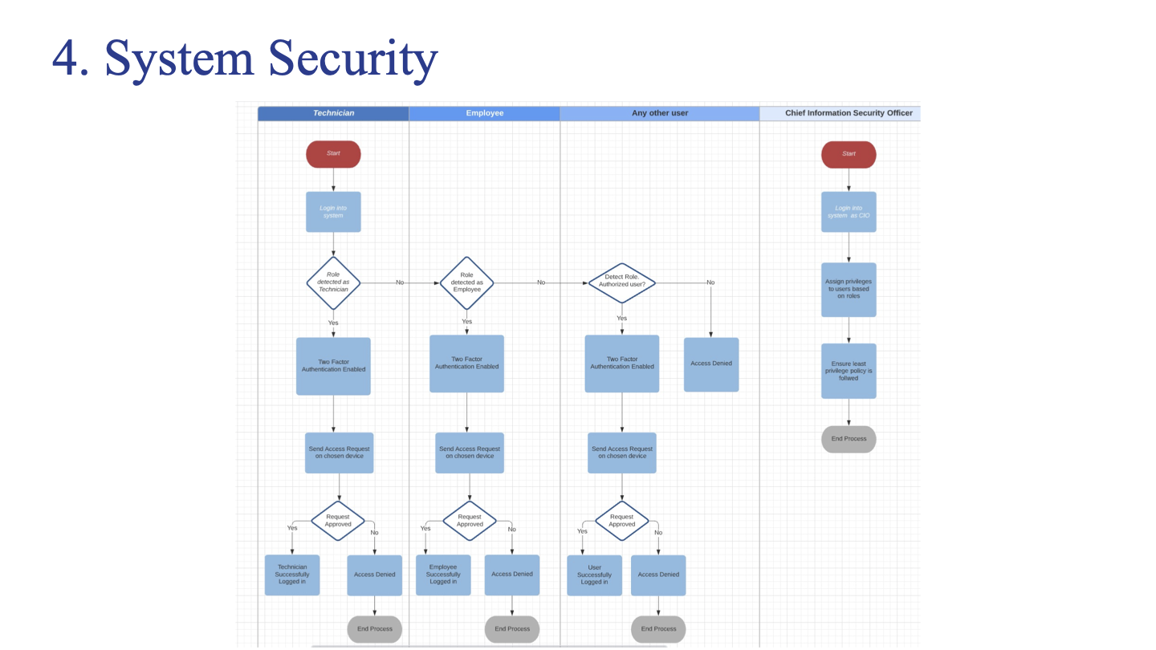
Impact
max growth
XX% sales increase

Slide 18
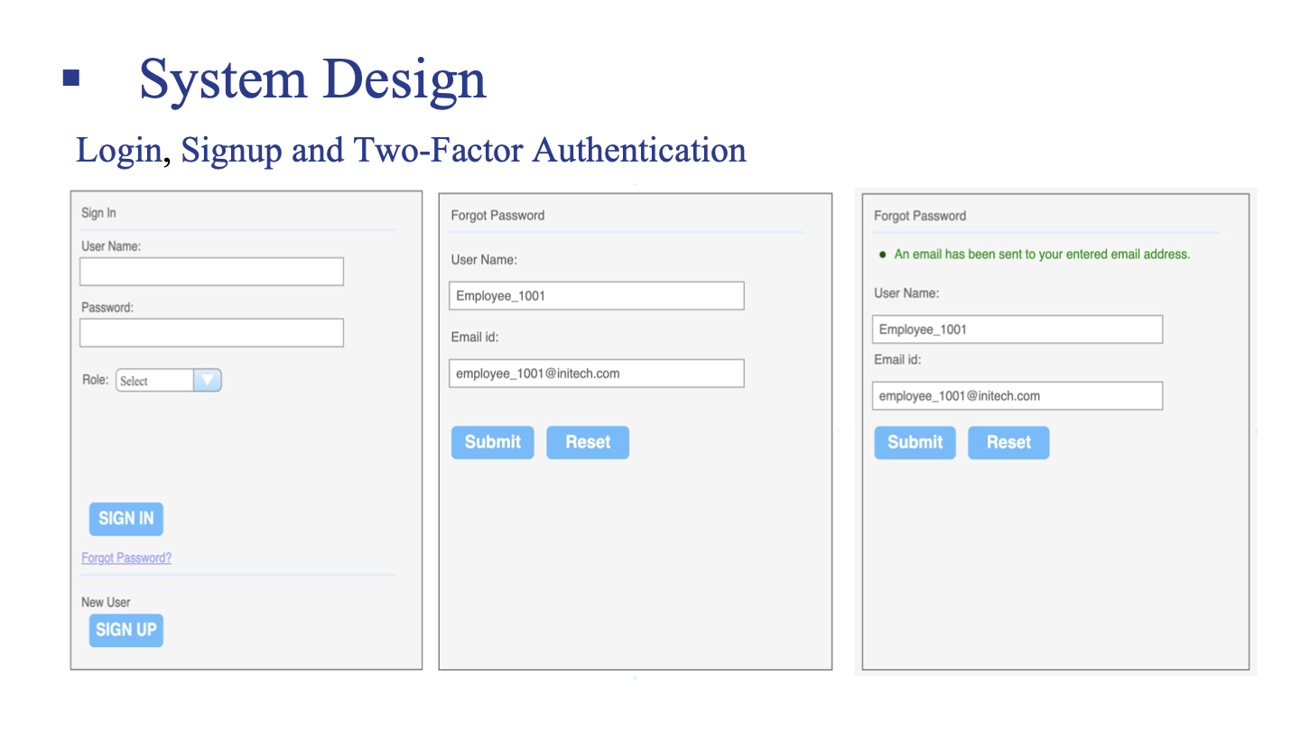

Slide 19
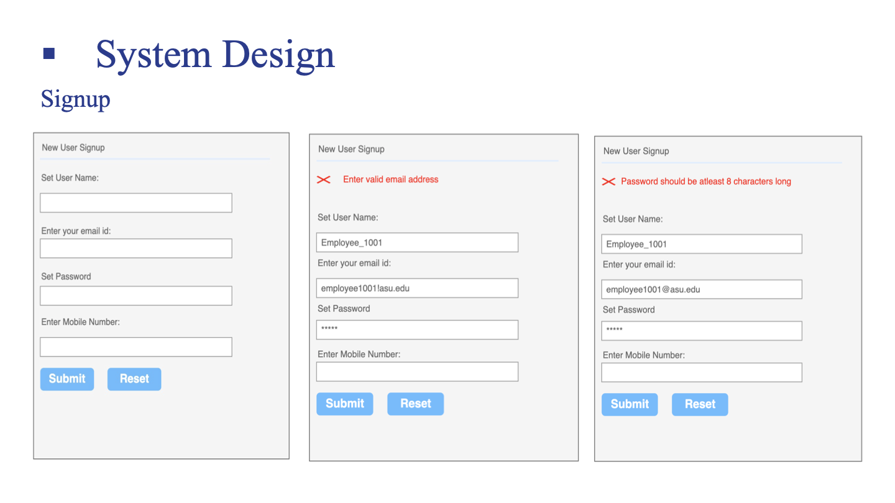

Slide 20
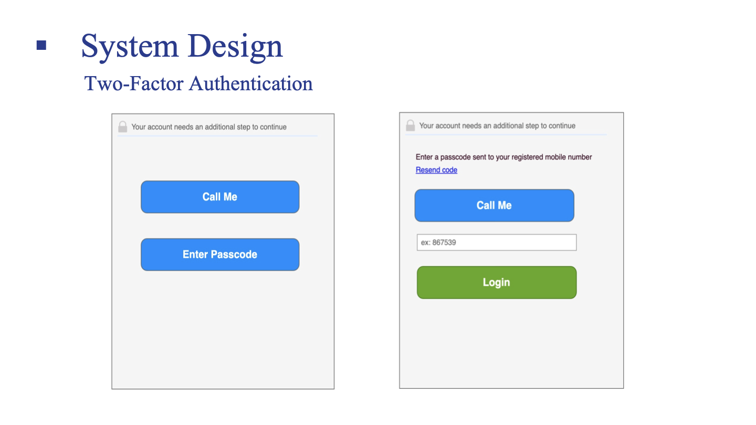

Slide 21
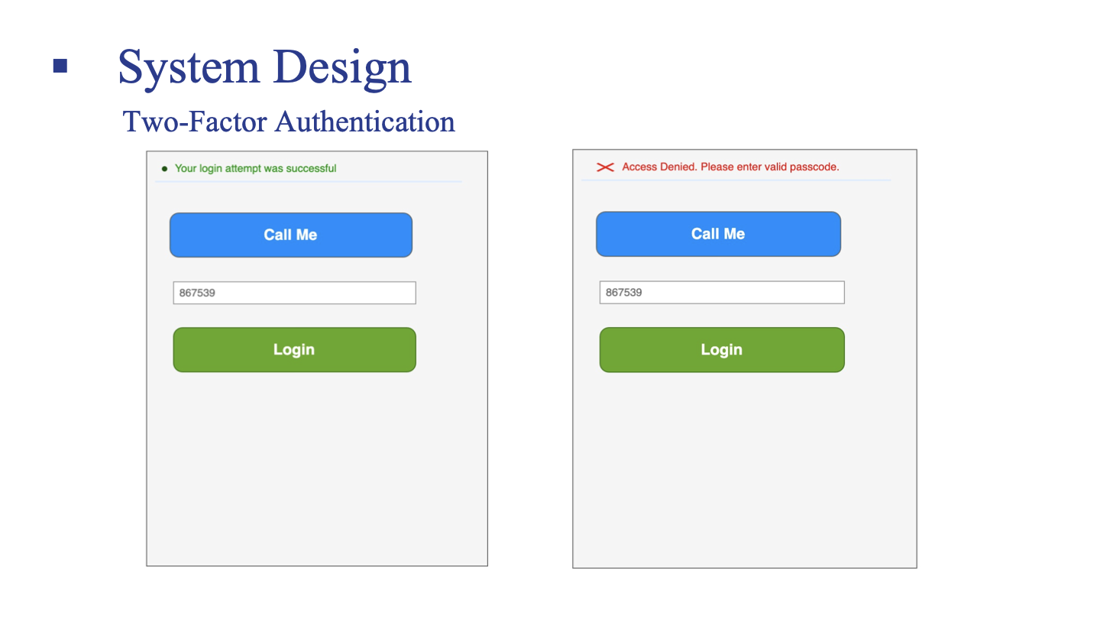

Slide 22
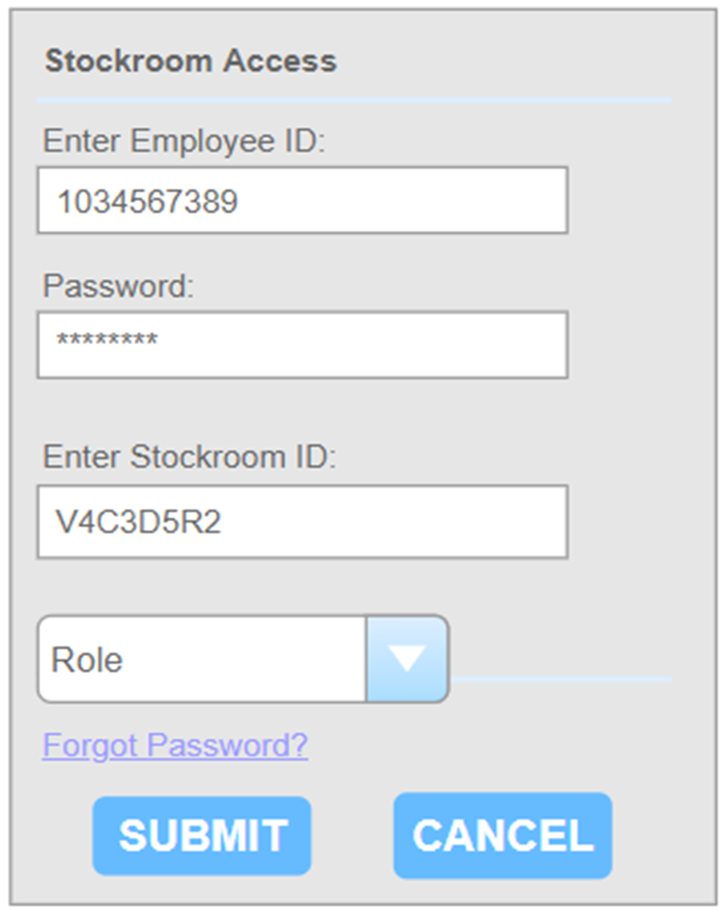
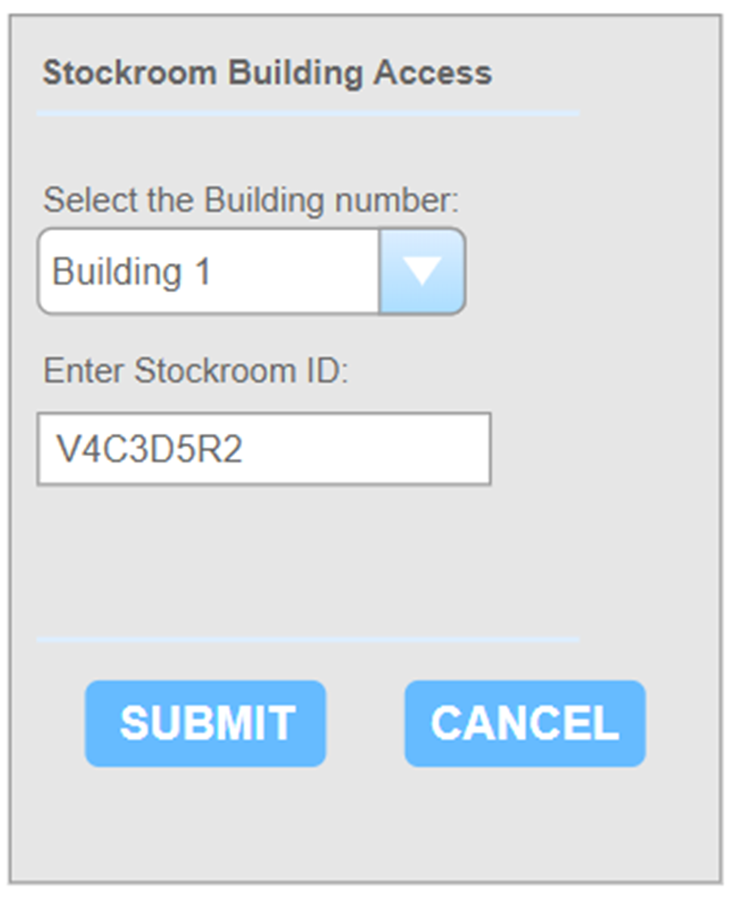
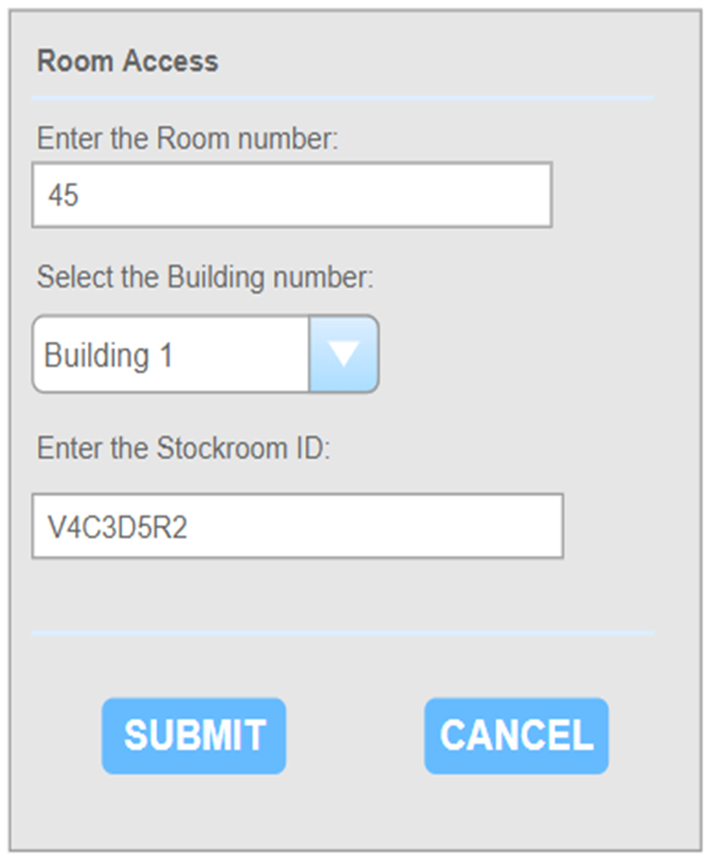
Stockroom Management

Slide 23
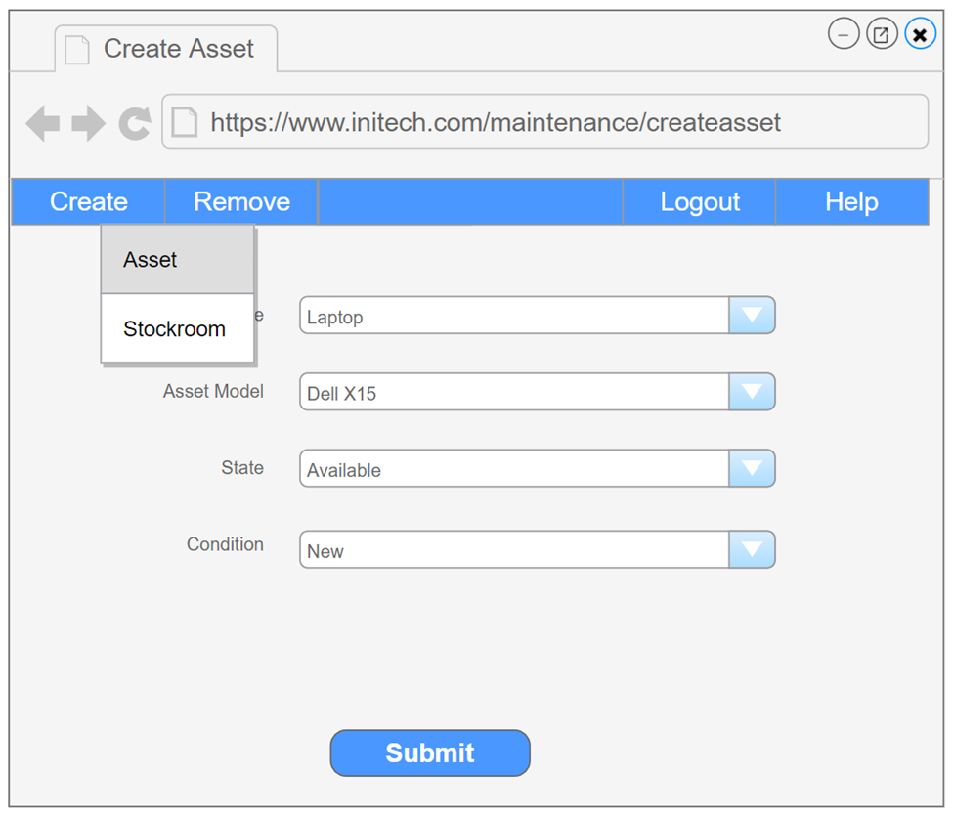
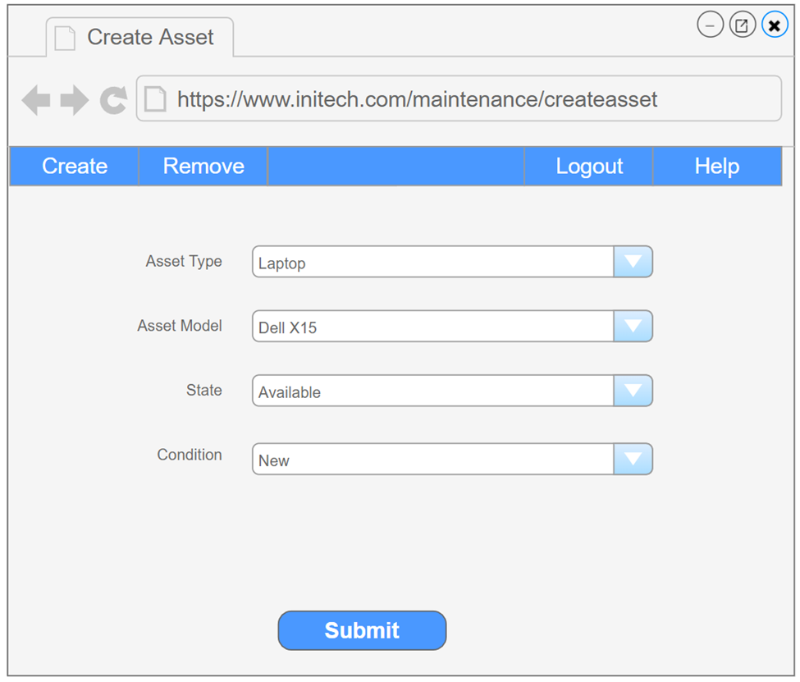
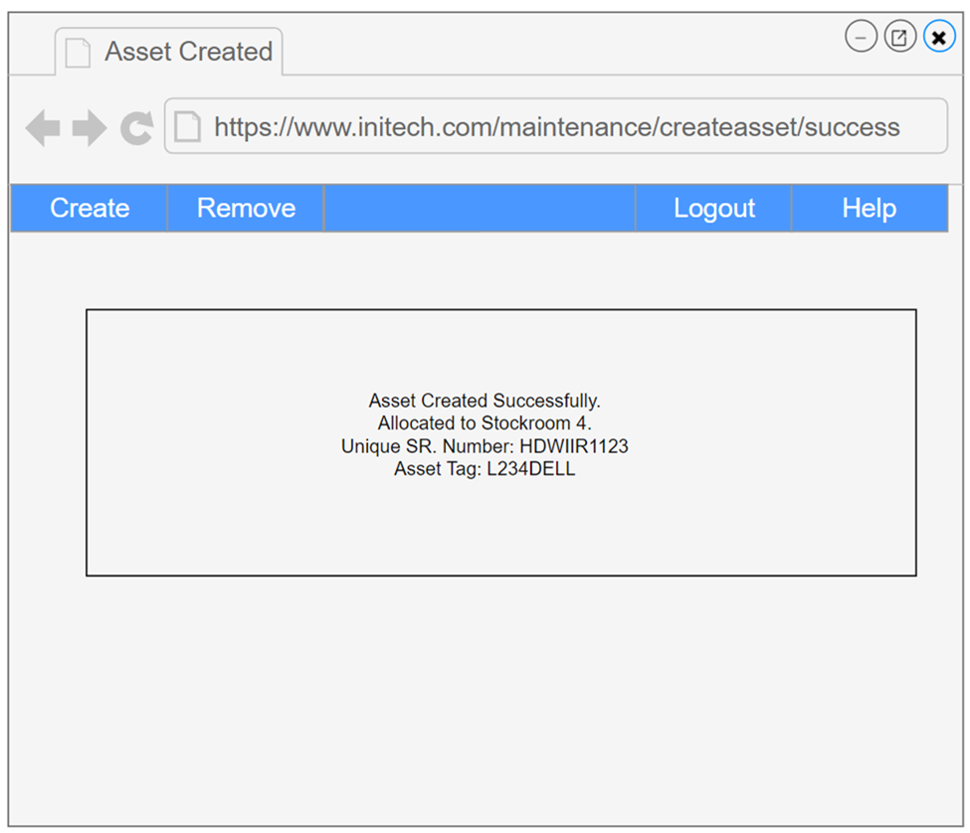
Asset Creation

Slide 24
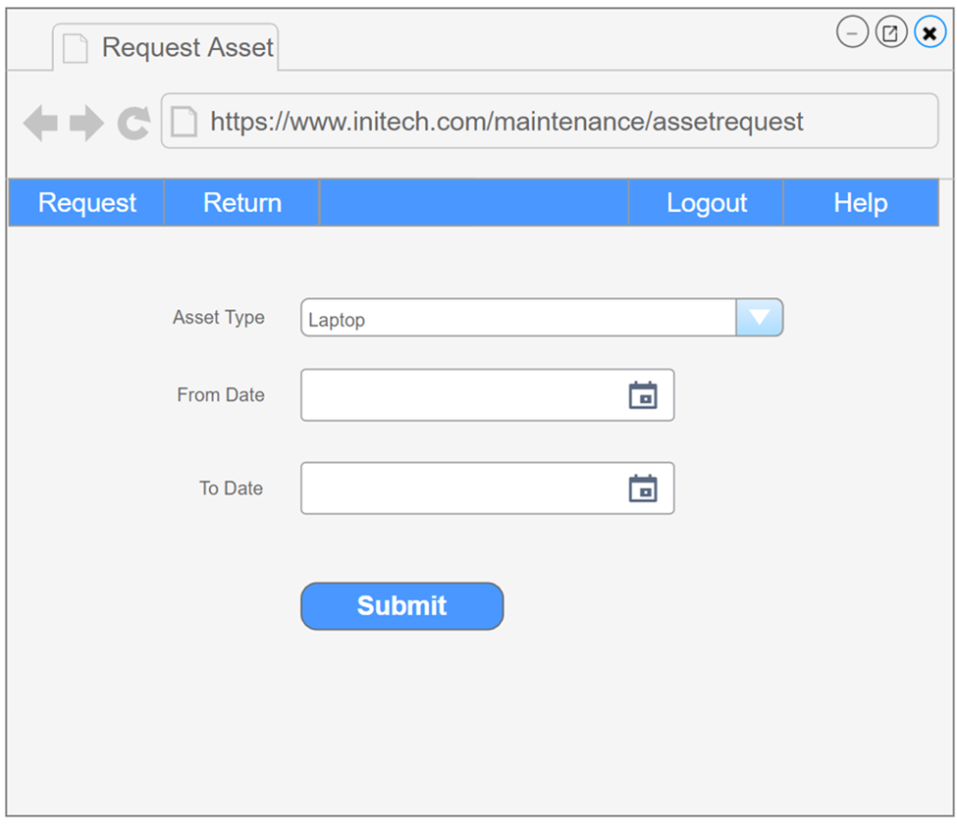
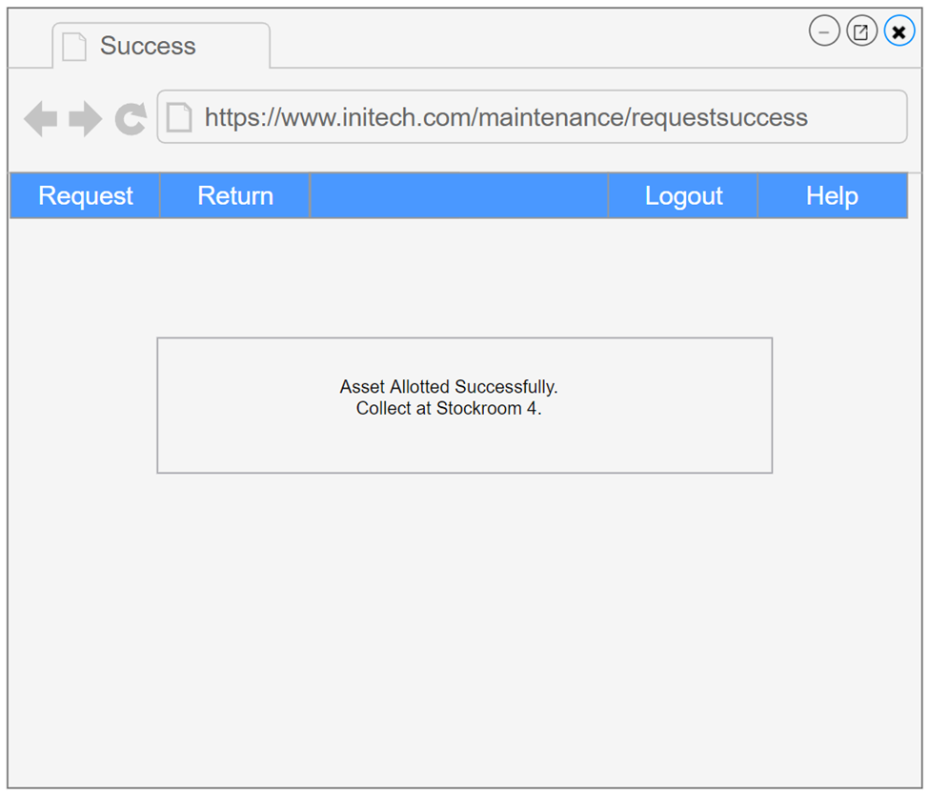
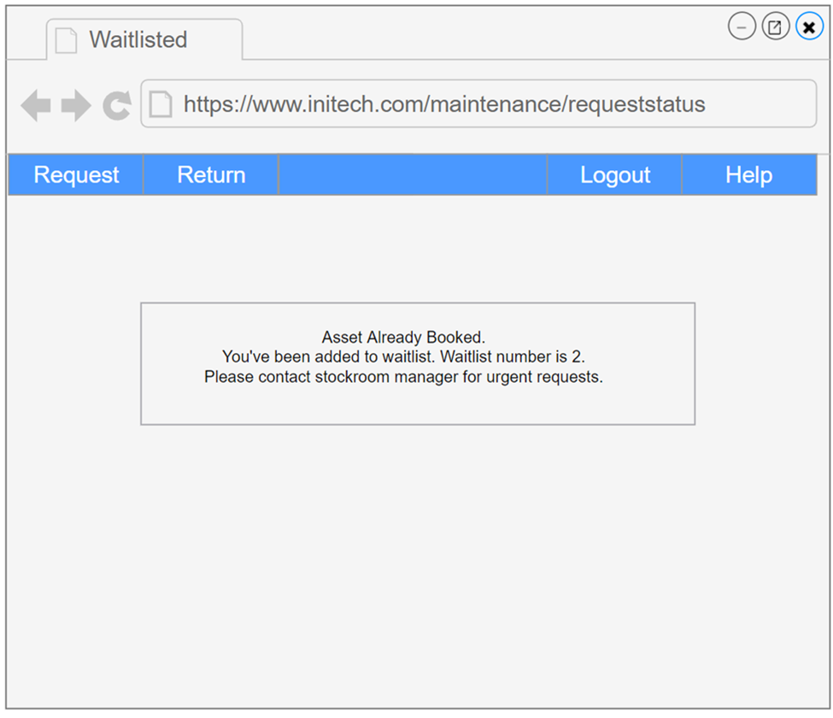
Request Process

Slide 25
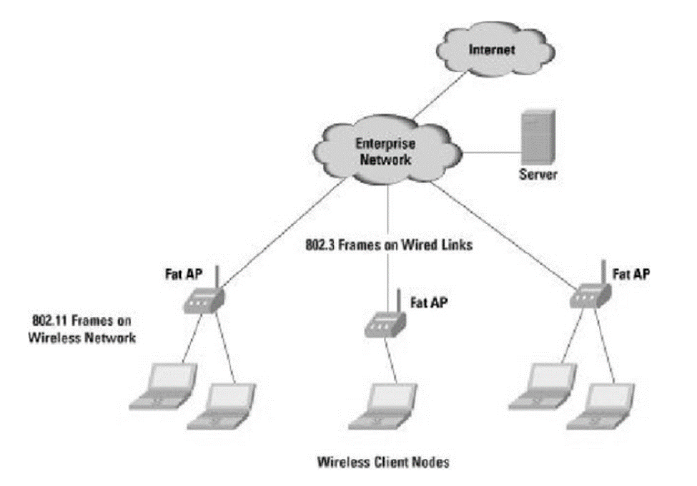
Infrastructure Architecture - Network Topology
Follows the WAN network
Different parts of the network will be connected to a central access point
All the wireless clients will be able to connect to this central access point/wireless access point and pull data from it.
Additional levels of security needs to be implemented to keep the data secure

Slide 26
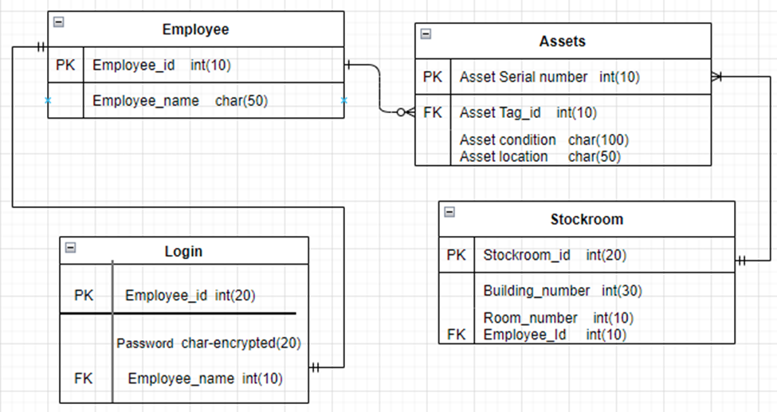
Infrastructure Architecture - Entity Relationship Diagram
An entity relationship diagram (ERD) shows the relationships
of entity sets stored in a database.
Our ER Diagram contains 4 tables which focus on delivering the
result to the Employees.
Each table in the ER diagram has a primary key denoted as PK. The foreign key is denoted as FK.

Slide 27
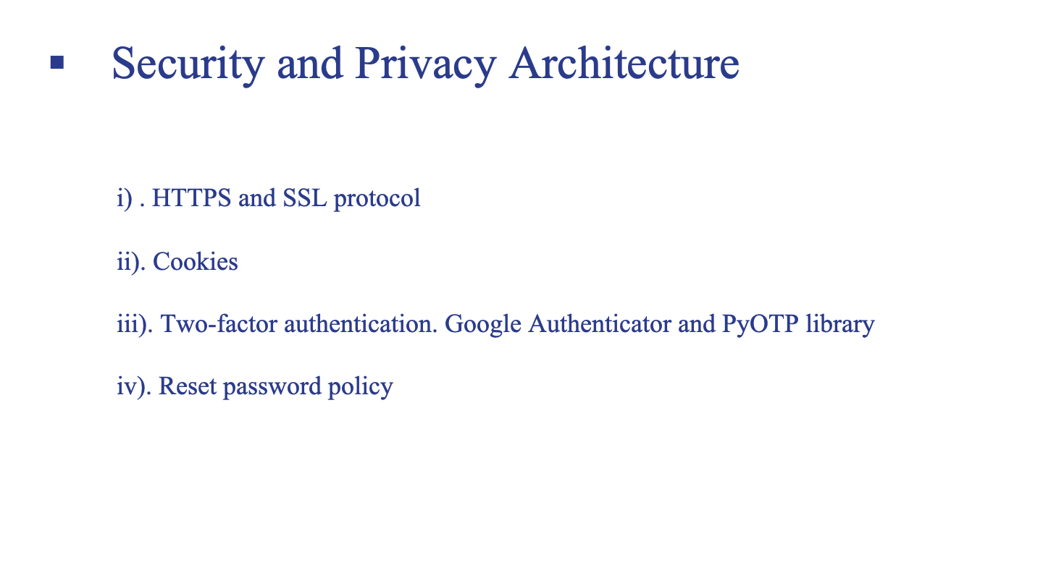

Slide 28
Technology Tools
Python
Django
MongoDB
HTML CSS
Javascript & Jquery

Slide 29
References
Tilley, S. (2019). Systems analysis and design (12th ed)., Boston, MA: Cengage Learning.
Initechsolutions, LLC. (2005) A brief guide on company history.
https://www.initechsolutions.com/system-management/
Nate, V. (2005). What is Initechsolutions, Specialities and why is it so popular? Medium.
https://www.linkedin.com/company/initech-solutions-llc/about/
LucidChart (n.d.). What is a Flow Chart and History? LucidChart.
https://www.lucidchart.com/pages/what-is-a-flowchart-tutorial

Slide 30
Softwaretesting, H. (2021, September 16) Best IT Asset management software?
https://www.softwaretestinghelp.com/it-asset-management-software/
SerializedAssets (n.d.). Brief about Serialized Inventory Management.
https://assetoptics.com/aolex/serialized-inventory-management/
Two-Factor authentication implementation
https://www.section.io/engineering-education/implementing-totp-2fa-using-flask/
https://cryptobook.nakov.com/more-cryptographic-concepts/one-time-passwords-otp-example
System Quality Requirements Engineering (SQUARE) Methodology: Case Study on Asset Management System
https://www.researchgate.net/publication/235051094_System_Quality_Requirements_Engineering_SQUARE_Methodology_Case_Study_on_Asset_Management_System/figures?lo=1&utm_source=google&utm_medium=organic

